Slide 1
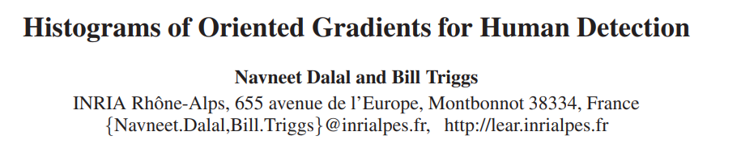
[HOG 人像检测] 王子猛

Slide 2
Introduction
“Detecting humans in images is a challenging task owing to their variable appearance and the wide range of poses that they can adopt. The first need is a robust feature set that allows the human form to be discriminated cleanly, even in cluttered backgrounds under difficult illumination.”
“We study the issue of feature sets for human detection, showing that locally normalized Histogram of Oriented Gradient (HOG) descriptors provide excellent performance relative to other existing feature sets”

Slide 3
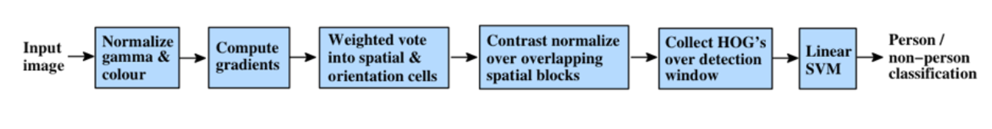
Overview
The method is based on evaluating well-normalized local histograms of image gradient orientations in a dense grid.
The basic idea is that local object appearance and shape can often be characterized rather well by the distribution of local intensity gradients

Slide 4
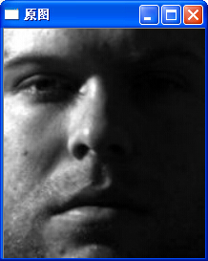
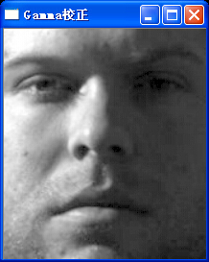

Implementation
Gamma Transformation
Reduce effect of difficult illumination

Slide 5
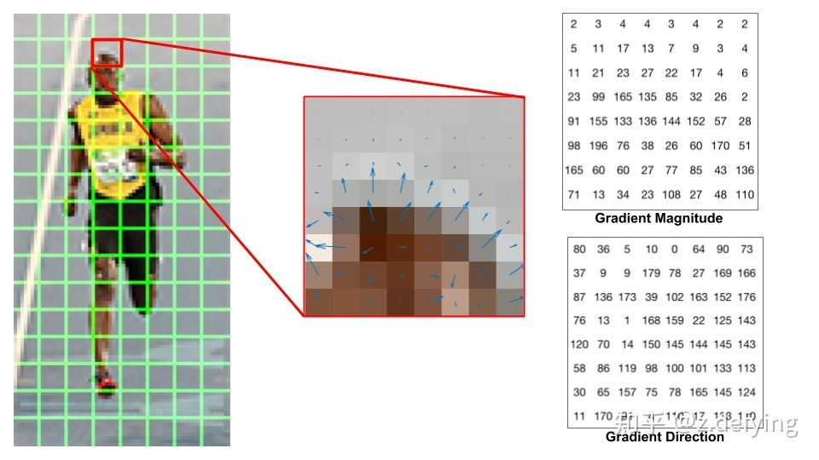
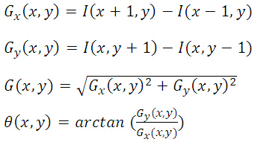
Implementation
Gradient
Calculate the gradient and direction

Slide 6
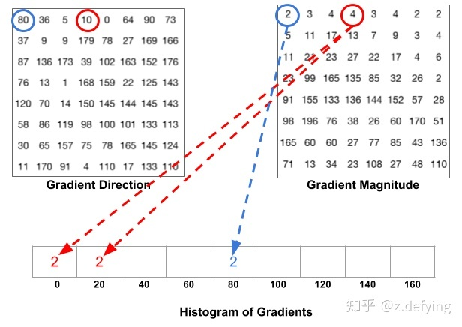
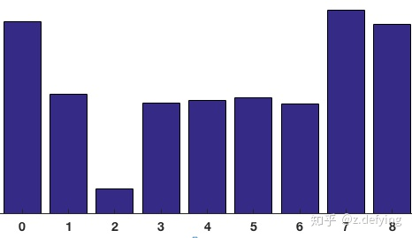
Implementation
Histogram

Slide 7
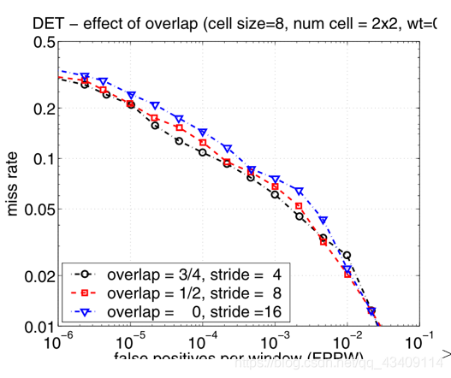
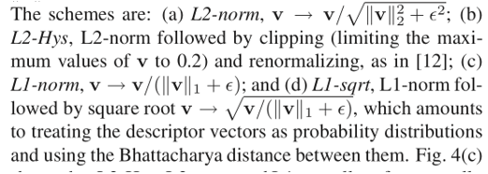
Implementation
Normalization

Slide 8
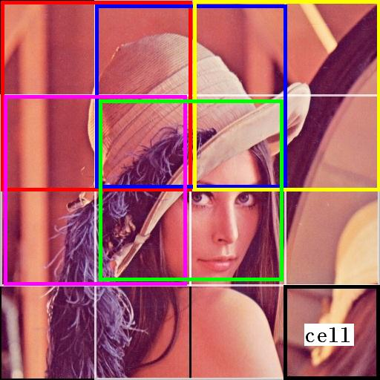
Implementation
Feature Detection + SVM

Slide 9
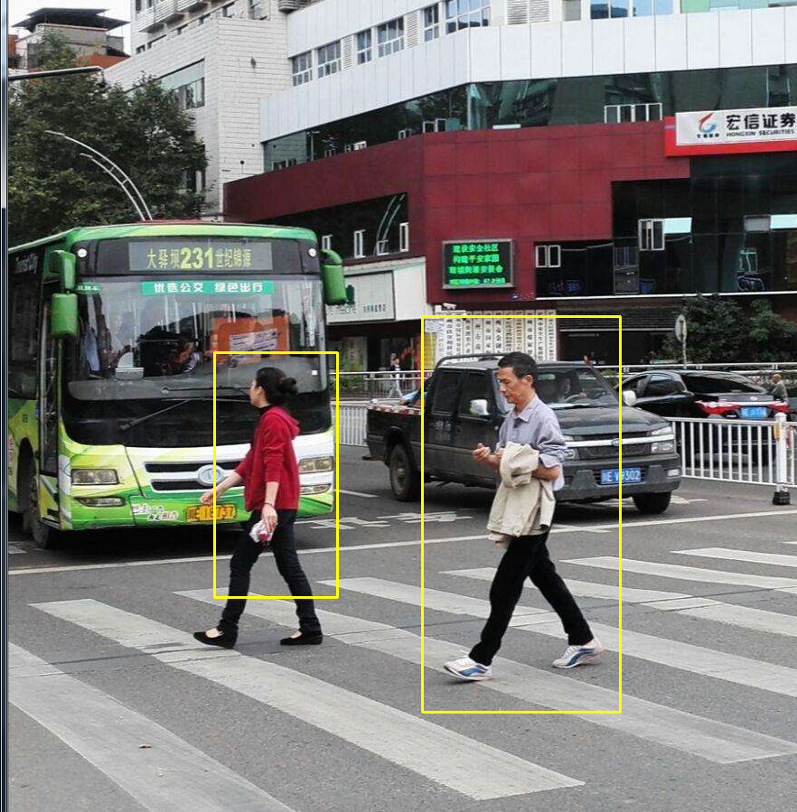
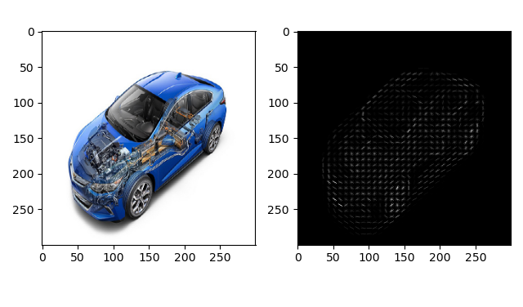
Expected Result

Slide 10
Thanks for listening & Q&A

